Slide 1
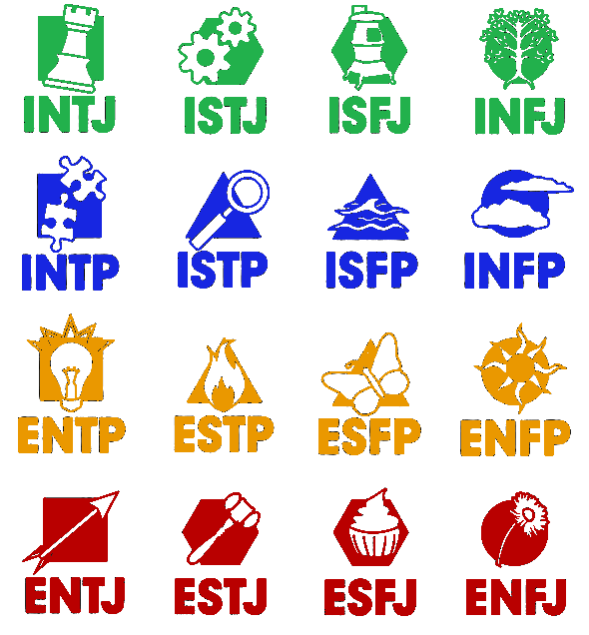
Myers-Briggs relationships
with 4 other models
IT: Conscientious
IF: Steady
IJ:
Melancholic
DiSC’s E/I-T/F
(4 quarters)
Mastermind
Inspector
Defender
Counselor
IP:
Phlegmatic
Keirsey (4 shapes)
NT: Rational/Analyst
NF: Idealist/Diplomat
SJ: Sentinel/Guardian
SP: Artisan/Explorer
Scientist
Craftsman
Artist
Idealist
NTP: Engineer
STP: Operator
SFP: Entertainer
NFP: Advocate
ET: Dominant
EF: Influential
EP:
Sanguine
Inventor
Entrepreneur
Performer
Discoverer
4 Temperaments
E/I-J/P (right side)
EJ:
Choleric
NTJ: Coordinator
SFJ: Conservator
STJ: Admin
NFJ: Mentor
Commander
Supervisor
Caregiver
Mentor
Herrmann’s S/N-T/F:
NT: Vision
ST: Logic
SF: Control
NF: People

Slide 2
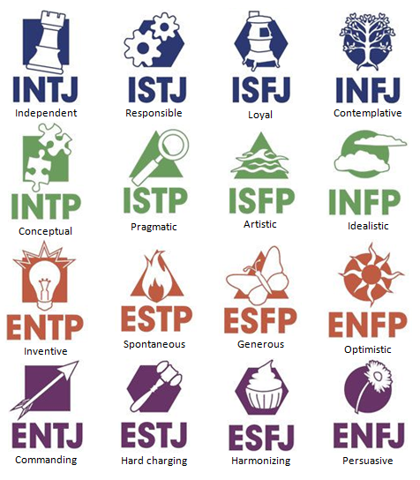
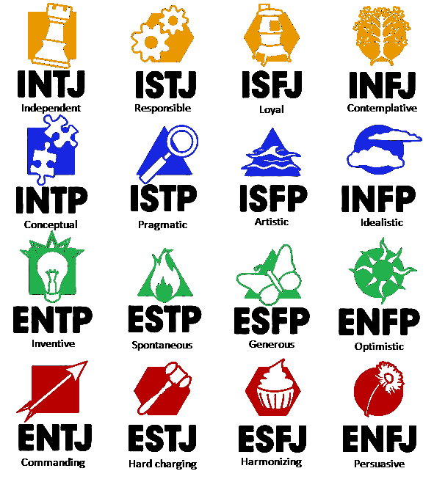
Herrmann’s SN-TF:
NT: Vision
ST: Logic
SF: Control
NF: People
Conscientiousness
Steady
IJ:
Melancholic
Keirsey:
NT: Rational/Analyst
NF: Idealist/Diplomat
SJ: Sentinel/Guardian
SP: Artisan/Explorer
IP:
Phlegmatic
NTP: Engineer
STP: Operator
SFP: Entertainer
NFP: Advocate
Dominance
Influence
EP:
Sanguine
DiSC’s EI-TF:
EJ:
Choleric
NTJ: Coordinator
STJ: Admin
SFJ: Conservator
NFJ: Mentor
4 Temperaments
EI-JP:

Slide 3
Herrmann’s SN-TF:
NT: Vision
ST: Logic
SF: Control
NF: People
Conscientiousness
Steady
Keirsey:
NT: Rational/Analyst
NF: Idealist/Diplomat
SJ: Sentinel/Guardian
SP: Artisan/Explorer
IJ:
Melancholic
IP:
Phlegmatic
NTP: Engineer
STP: Operator
SFP: Entertainer
NFP: Advocate
Dominance
Influence
EP:
Sanguine
4 Temperaments
EI-JP:
EJ:
Choleric
NTJ: Coordinator
STJ: Admin
SFJ: Conservator
NFJ: Mentor
DiSC’s EI-TF:

